Slide 1
C18TP
Entrepreneurial Leadership

Slide 2
defining leadership
what is it all about?
Notes:
if you are going to define leadership in a sentence, how would it sound like?

Slide 3
Leadership – what is it?
Conger (1992: 18) define leadership as “individuals who establish direction for a working group of individuals who gain commitment from this group of members to this direction and who then motivate these members to achieve the direction’s outcomes”.
Notes:
Conger’s definition involves the following.
The individuality of leaders.
Their focus in providing direction.
The presence of a group, that is, leadership operates in groups.
The involvement of the followers via commitment (The degree of commitment can differ).
Leadership is about influencing through motivation.
Leadership includes the achievement of goals, which leaders and follows share.

Slide 4
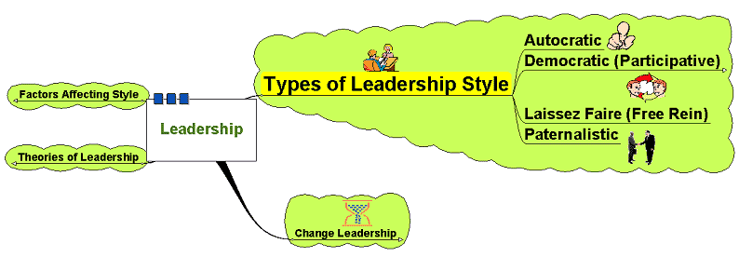
Types of Leadership Style

Slide 5
Types of Leadership Style
Autocratic:
  Leader makes decisions without reference to anyone else
  High degree of dependency on the leader
  Can create de-motivation and alienation
  of staff
  May be valuable in some types of business where decisions need to be made quickly and decisively
A style of leadership in which the leader uses strong, directive, controlling actions to enforce the rules, regulations, activities and relationships in the work environment.

Slide 6
Who are Autocratic Leaders?
Notes:
Can you think of some Autocratic Leaders?
Schools
Parents
Where are some places/organizations where we might need Autocratic Leaders?
Many military leaders are considered Autocratic Leaders.
Why would it be advantageous to use an Autocratic Style in the military?
Prison systems almost have to use an autocratic style, along with other places where it is too risky to leave anything questionable and unanswered.
Factories often require high volume production on a daily basis—we often see autocratic leadership styles used to increase efficiency

Slide 7
Exercise
Can you think of the disadvantages of Autocratic Leadership?

Slide 8
Types of Leadership Style
Democratic:
  Encourages decision making
  from different perspectives – leadership may be emphasised throughout
  the organisation
  May help motivation and involvement
  Workers feel ownership of the firm and its ideas
  Improves the sharing of ideas
  and experiences within the business
  Can delay decision making
A style of leadership in which the leaders takes collaborative, responsive, interactive actions with followers concerning the work and the work environment.

Slide 9
Who are Democratic Leaders?
Notes:
Obviously, our country was founded out of democratic ideas. Our government acts as a democracy that encourages involvement and allows every American to actively participate and voice their concerns, if they choose to do so.
Does this mean that all of our political leaders are democratic leaders?
A democratic leadership style is also commonly used in situation where the leader needs too and wants to encourage team building. There is no better way to encourage true team collaboration than allowing the members to be actively involved in a group processes and decisions.

Slide 10
Exercise
Read the case in the chapter and answer questions.
Do you think Chris has made the right choice, if so, why?
What are the main drawbacks of using this style and how could this effect the project as a whole?

Slide 11
Types of Leadership Style
Laissez-Faire:
  ‘Let it be’ – the leadership responsibilities
  are shared by all
  Can be very useful in businesses
  where creative ideas are important
  Can be highly motivational,
  as people have control over their working life
  Can make coordination and decision making
  time-consuming and lacking in overall direction
  Relies on good team work
  Relies on good interpersonal relations
  Improves the sharing of ideas
  and experiences within the business
  Can delay decision making

Slide 12
Types of Leadership Style
Laissez-Faire:
A style of leadership in which the leader fails to accept the responsibilities of the position.

Slide 13
When to use Laissez-Faire
Employees are highly skilled, experienced, and educated
Employees have pride in their work and the drive to do it successfully on their own
Outside experts, such as staff specialists or consultants are being used
Employees are trustworthy and experienced
Notes:
This is an effective style to use when:
--Employees are highly skilled, experienced, and educated.
--Employees have pride in their work and the drive to do it successfully on their own.
--Outside experts, such as staff specialists or consultants are being used
--Employees are trustworthy and experienced.
This style should not be used when:
--It makes employees feel insecure at the unavailability of a manager.
--The manager cannot provide regular feedback to let employees know how well they are doing.
--Managers are unable to thank employees for their good work.
--The manager doesn’t understand his or her responsibilities and is hoping the employees can cover for him or her.
Some risks are involved with Laissez-Faire Leadership. Followers may like them, but some people find events around them confusing and chaotic. They also may feel that the leader does not respect their time and energy. Most importantly, they may not see where their contribution fits and slowly become less committed and enthusiastic.

Slide 14
Exercise
Suggest different situations Laissez-faire leadership style is not suitable.

Slide 15
Situational Leadership Style
The fundamental underpinning of the situational leadership theory is that there is no single "best" style of leadership.

Slide 16

Models and Theories of Leadership
Trait Theory (30’s)
Behavioral Theory (40’s and 50’s)
Contingency Theory (60s and 70s)
Transformational Theory (80s up)
Transactional Theory
Entrepreneurial Leadership
Notes:
four main generations; but none of them is mutually exclusive nor time bound
each generation has added to the overall debate of what leadership is all about
each generation has a variation or has been tweaked according to different studies

Slide 17
Trait Theory
Is there a set of characteristics that determine a good leader?
  Personality?
  Dominance and personal presence?
  Charisma?
  Self confidence?
  Achievement?
  Ability to formulate a clear vision?

Slide 18
Leadership Trait Questionnaire (LTQ)
The purpose of this questionnaire is to measure personal characteristics of leadership. The questionnaire should be completed by the leader and five people who are familiar with the leader. Make five copies of this questionnaire.
Follow the instructions.

Slide 19
Behavioural Theory
Imply that leaders can be trained – focus on the way of doing things
  Structure based behavioural theories – focus on the leader instituting structures – task orientated
  Relationship based behavioural theories – focus on the development and maintenance of relationships – process orientated

Slide 20
Studies that Identified behavioural Patterns of Leaders
The Ohio State Leadership Studies
The Michigan Leadership Studies
Blake and Mouton’s (1964) managerial grid.

Slide 21
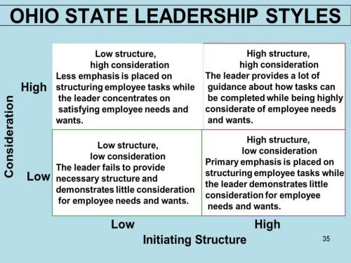
The Ohio State studies
Notes:
Consideration refers to the extent to which a leader is likely to have job relationships which are characterized by mutual trust, respect for subordinates’ ideas and regard for their feelings. He shows concern for his followers’ comfort, well-being, status and satisfaction.
Initiating structure refers to the extent to which a leader is likely to define and structure his own role as well as the roles of subordinates in the search for goal attainment. It includes behaviour that attempts to organise work, work relationships and goals. The leader characterized as high in initiating structure specifies the task to be performed by each member of his group, sets down deadlines, gives directions and puts pressure on them for its fulfillment.
The Ohio State University studies viewed these two behaviours as distinct and independent. The Ohio State Studies suggested that the “high-high” leadership style (high in initiating structure as well as in consideration) generally results in positive outcomes but there are exceptions which indicate that situational factors should be integrated into the theory.

Slide 22
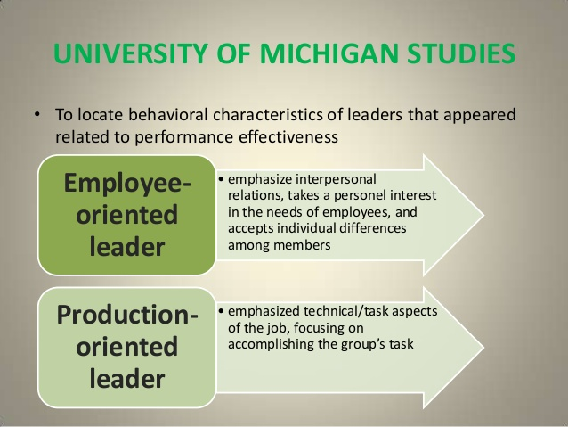
The Michigan studies
Notes:
The Michigan researchers favoured the leaders who were employee- oriented in their behaviour. Employee-oriented leaders were associated with higher group productivity and higher job satisfaction. Production- oriented leaders were associated with low group productivity and lower worker satisfaction.

Slide 23
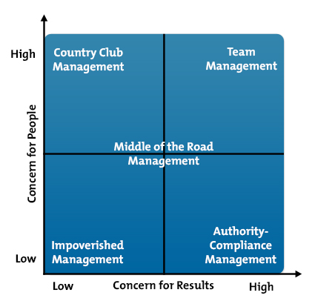
Blake and Mouton Managerial Grid
Notes:
Impoverished - laissez faire leadership; do enough just to get by
Country Club - avoid conflicts and concentrate on being well-liked; keep people happy
Authority-Compliance Management= there is tight control, strict compliance; creativity and human relations are not necessary
Middle of the road - attempt to balance people and task but commitment is questionable
Team Leader - considered to be ideal; work to motivate employees to reach their highest levels of accomplishment; flexible and responsive to change and they understand to need the change

Slide 24
Exercise
Applying the Blake Mouton Managerial Grid

Slide 25
Hersey-Blanchard Situational Leadership
Based on the amount of direction (task-behavior) and amount of socio-emotional support (relationship-behavior) a leader must provide given the situation and the "level of maturity" of the followers.

Slide 26
Transactional Theory
  Focus on the management
  of the organisation
  Focus on procedures and efficiency
  Focus on working to rules
  and contracts
  Managing current issues
  and problems

Slide 27
Transformational theory
  Widespread changes to a business or organisation
Requires:
  Long term strategic planning
  Clear objectives
  Clear vision
  Leading by example – walk the walk
  Efficiency of systems and processes
Research indicates that transformational leadership is more strongly correlated with lower turnover rates, higher productivity, and higher employee satisfaction.

Slide 28
Entrepreneurial Leadership
Entrepreneurial leadership starts with having an entrepreneurial mindset.
Leading like an entrepreneur:
  Always involves creation of value through change of assets to develop a new business
  Always involves inspiring employees to capture that business opportunity
    “Employees won’t be managed, but they can be led.”

Slide 29
Exercise
Discuss the similarities in Transformational leaders and Entrepreneurial Leaders.

Slide 30
Transformational vs. Entrepreneurial Leadership
Transformational:
  Bring about a change in existing order
    Change is the key
Entrepreneurial:
  Bring about a new order
    Create something which did not exist before
      New learning is always involved

Slide 31
Transformational and Entrepreneurial Leadership
But:
Transformational leaders and entrepreneurial leaders are linked in leadership qualities:
  passion
  vision
Transformational leadership may become entrepreneurial leaders
Transformational leaders productively co-exist with entrepreneurial leaders, particularly in corporate environments

Slide 32
Entrepreneurial Leadership skills
The ‘work-oriented approach’
  scholars identify three specific personal competencies for entrepreneurial leader that include: proactiveness, innovativeness and risk taking.
‘socio-cultural and situated approach’
  explains entrepreneurial leadership development as a social process of continuous and gradual learning

Slide 33
Reading list
Burns, J. M. (1978), Leadership, New York: Harper and Row.
Bryman, A. (Ed.). (2011). The SAGE handbook of leadership. Sage Publications.

